Slide 1
Chapter 6 Preparing Data for Machine Learning
Data collection, preparation, and normalization is one of the primary steps in any machine learning experiment.
Almost all of the machine learning algorithms (there are some interesting exceptions though) work with vectors of numbers.
So regardless of the kind of original data you are working with, you should know how to convert it into a usable format without losing necessary details.

Slide 2
We will begin this chapter by first looking at different kinds of data variables that we expect to find in our experiments.
After establishing that distinction, we will get in depth of processing well-structured data from comma-separated values (CSV) files – which would help us understand how to deal with data inconsistencies, missing data, etc., followed by feature selection and feature generation – which will help us convert rows of data into numerical vectors.
We will then discuss the standard methods to vectorize text and images, which are the most popular unstructured types of data.

Slide 3
Types of Data Variables
There are primarily two types of data variables based on this distinction.
Continuous variables, which can take any positive or negative real number. For example, your height might be measured as 170 cm.
Discrete variables, which can take only a particular value from the allowed set of possible values. For example, names of cities, level of an employee, etc.

Slide 4
Variables can be thought as being on one of the four scales – nominal, ordinal, interval, or ratio.
  Nominal Data: Nominal data is a type of data that can take any arbitrary nonnumerical values. This kind of data can neither be measured nor compared. For example, names, address, gender, etc., can be regarded as nominal data attributes.
  Ordinal Data: Ordinal data is a type of data whose values follow an order. Though the values don’t have a notion of differences and increments, they can be compared as being greater than, lesser than, or equal to each other. For example, T-shirt sizes (S, M, L, XL, etc.), Likert scale in customer surveys (Always, Sometimes, Rarely, Never), and so on are examples of ordinal data.

Slide 5
  Interval Data: Interval data is a type of data that has properties of ordinal data (values can be compared), and the intervals are equally split. A good example is the Degrees Fahrenheit scale of temperatures.
  Ratio Data: Ratio data is a type of data that has a natural zero point and supports all the properties of interval data, along with arithmetic operations of multiplication, division, etc.

Slide 6
Transformation
One of the first steps you would require in any machine learning experiments is to prepare the data and transform it to the form that the algorithm accepts.
In some cases, you will need to figure out and extract the required signals and prepare a vector or elements that will represent the data. This process is called feature extraction.

Slide 7
Your attempt for treating any real-world data point will be to convert it into feature vectors.
Most of these attributes will need to be transformed. If we choose an algorithm that expects each attribute to be strictly numerical, we might need some of the following transformations to convert nonnumeric features into numeric.

Slide 8
Name: Will be considered meaningless for such approaches. We will need to remove this field.
Date of birth: We can use this field to find the current age of the student.
Gender: Can be one of the various choices. We will see how to process these in the next section.
Highest achieved education level: Can be one of the various choices. Because this is ordinal in nature, we can try a different approach. This will be explained in the following section.
Marks in each course: Can be combined to find the aggregate and bucketed into different grade levels.

Slide 9
Transforming Nominal Attributes
Consider the Gender attribute, which may have three values – Male, Female, and Other.
One-hot encoding
  Edward Remirez, Male, 28 years, Bachelors Degree
  Edward Remirez, 0, 1, 0, 28 years, Bachelors Degree
Scikit-learn provides simple interface for such transformation using sklearn.preprocessing.

Slide 10
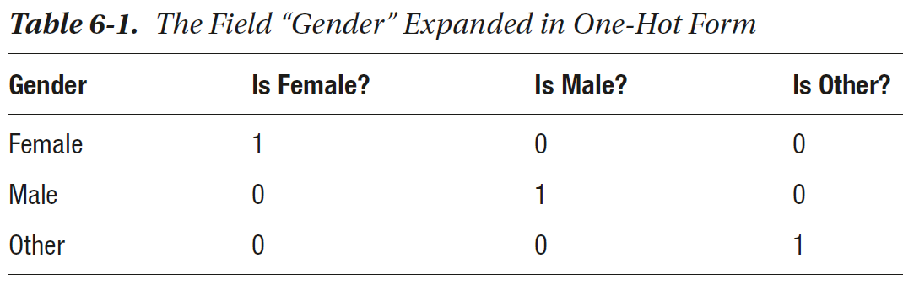

Slide 11
Let’s prepare a simple dataframe for this example.
  import pandas as pd
  df = pd.DataFrame([["Edward Remirez","Male",28,"Bachelors"],
  ["Arnav Sharma","Male",23,"Masters"],
  ["Sophia Smith","Female",19,"High School"]], columns=['Name','Gender','Age',
  'Degree'])
  print(df)

Slide 12
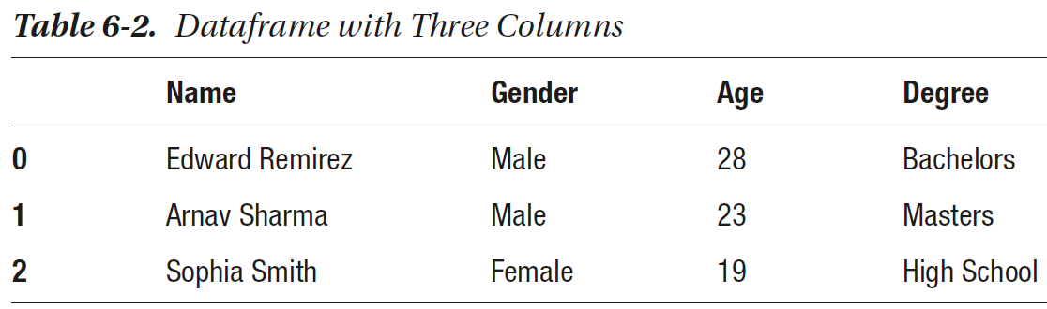

Slide 13
We need to import the necessary class from sklearn.preprocessing and fit an object of OneHotEncoder.
To convert your data into transformed attributes, use the following:
  gender_values = encoder_for_gender.transform(df[['Gender']])
gender_values is a sparse matrix; that is, the elements are stored only where the nonzero values are present. You can convert it to NumPy array using
  gender_values.toarray()
You can repack these values in the dataframe using
  df[['Gender_F', 'Gender_M']] = gender_values.toarray()

Slide 14
  import pandas as pd
  df = pd.DataFrame([["Edward Remirez","Male",28,"Bachelors"],
  ["Arnav Sharma","Male",23,"Masters"],
  ["Sophia Smith","Female",19,"High School"]], columns=['Name','Gender','Age',
  'Degree'])
  print(df)
  from sklearn.preprocessing import OneHotEncoder
  encoder_for_gender = OneHotEncoder().fit(df[['Gender']])
  print(encoder_for_gender)
  print(encoder_for_gender.categories_)
  gender_values = encoder_for_gender.transform(df[['Gender']])
  print(gender_values.toarray())
  df[['Gender_F', 'Gender_M']] = gender_values.toarray()
  print(df)

Slide 15
Transforming Ordinal Attributes
Some attributes have relative ordering of values – these can be transformed in a slightly simpler manner that would also preserve the information about the ordering and help create more meaningful models.
We can assign a numeric value to each label, thus High School being 0, Bachelors as 1, Masters as 2, and Doctorate as 3.
  Edward Remirez, Male, 28 years, Bachelors Degree
  Edward Remirez, 0, 1, 0, 28 years, 1

Slide 16
Here’s a quick example to convert Degree attribute to Ordinal Encoding.
  from sklearn.preprocessing import OrdinalEncoder
  df = pd.DataFrame([["Edward Remirez","Male",28,"Bachelors"],
  ["Arnav Sharma","Male",23,"Masters"],
  ["Sophia Smith","Female",19,"High School"]], columns=['Name','Gender','Age','Degree'])
  encoder_for_education = OrdinalEncoder()
  encoder_for_education.fit_transform(df[['Degree']])
  print(encoder_for_education.categories_)
  encoder_for_education = OrdinalEncoder(categories = [['Masters',
  'Bachelors','High School', 'Doctoral']])
  df[['Degree_encoded']] = encoder_for_education.fit_transform(df[['Degree']])
  print(df)

Slide 17
Normalization
Another important preprocessing step is to normalize the data so that the features are in a similar range.
It is highly important especially in case of experiments that use algorithms that are affected by the distribution shape or are based on vector- or distance-based computations.

Slide 18
Sample code
  import pandas as pd
  df = pd.DataFrame({'Age': {0: 28, 1: 23, 2: 19},
  'Gender_F': {0: 0.0, 1: 0.0, 2: 1.0},
  'Gender_M': {0: 1.0, 1: 1.0, 2: 0.0},
  'Degree_encoded': {0: 0.0, 1: 2.0, 2: 1.0}})
  print(df)

Slide 19
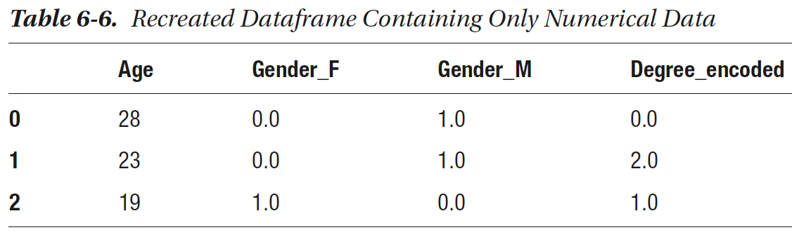

Slide 20
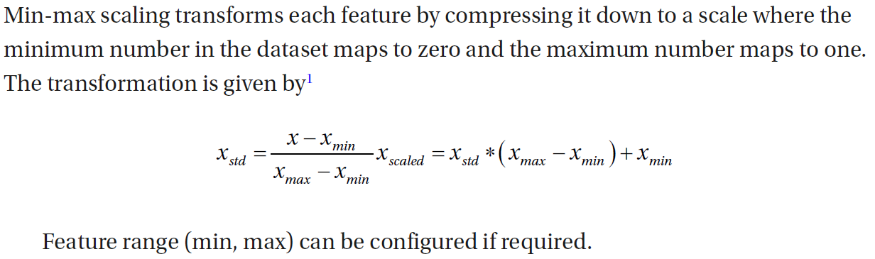
Min-Max Scaling

Slide 21
  import pandas as pd
  df = pd.DataFrame({'Age': {0: 28, 1: 23, 2: 19},
  'Gender_F': {0: 0.0, 1: 0.0, 2: 1.0},
  'Gender_M': {0: 1.0, 1: 1.0, 2: 0.0},
  'Degree_encoded': {0: 0.0, 1: 2.0, 2: 1.0}})
  print(df)
  from sklearn.preprocessing import MinMaxScaler
  scaler = MinMaxScaler()
  scaler.fit(df[['Age']])
  df['Age'] = scaler.transform(df[['Age']])
  print(df)

Slide 22
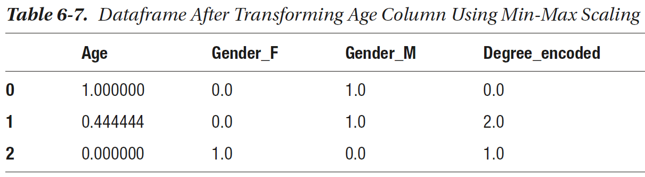

Slide 23
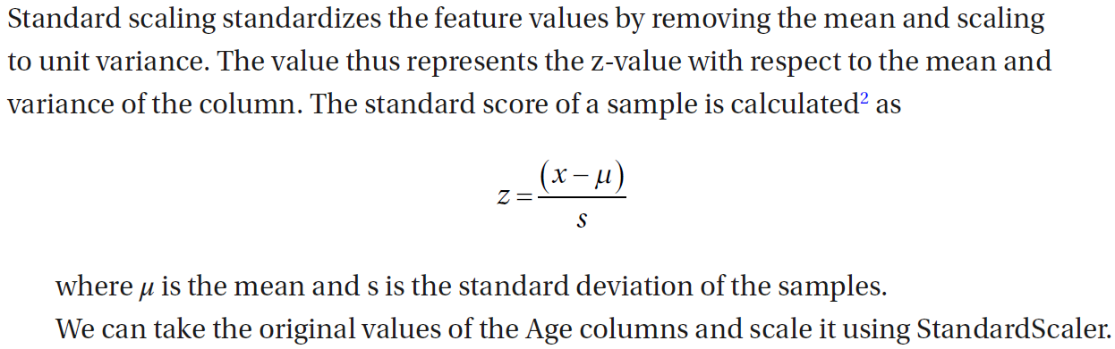
Standard Scaling

Slide 24
  import pandas as pd
  df = pd.DataFrame({'Age': {0: 28, 1: 23, 2: 19},
  'Gender_F': {0: 0.0, 1: 0.0, 2: 1.0},
  'Gender_M': {0: 1.0, 1: 1.0, 2: 0.0},
  'Degree_encoded': {0: 0.0, 1: 2.0, 2: 1.0}})
  print(df)
  from sklearn.preprocessing import StandardScaler
  scaler = StandardScaler()
  scaler.fit(df[['Age']])
  df['Age'] = scaler.transform(df[['Age']])
  print(df)
  print(scaler.mean_)
  print(scaler.scale_)

Slide 25
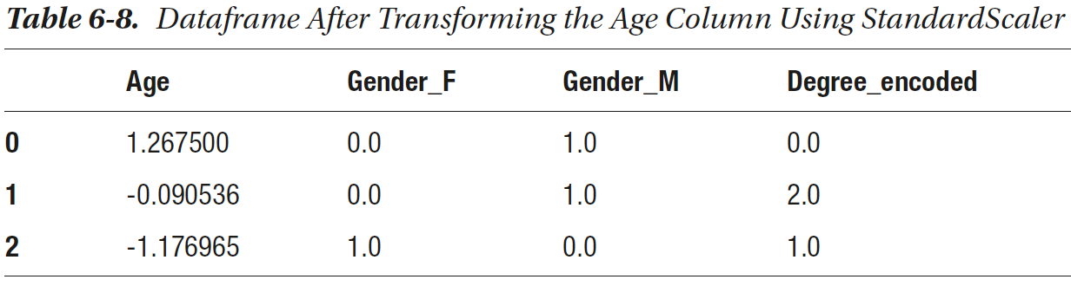

Slide 26
Preprocessing Text
A lot of real-world data is present in the form of text – maybe as comments to a survey, or a product review on an ecommerce website, or as a social media text that we want to leverage.
The subject of processing, understanding, and generating text is covered under a major field of study called Natural Language Processing (NLP).
In this section, we will explain basic techniques for converting text to vectors that might be required by some of the future examples in this book.

Slide 27
Preparing NLTK
One of the most popular libraries for NLP in Python is NLTK, or Natural Language ToolKit.
Check the installation of NLTK.
  from nltk.tokenize import word_tokenize
If you are using NLTK for the first time, using NLTK functions can lead to an error that might look like the following. This means the pretrained models required for basic operations of NLTK are not present in your system.

Slide 28
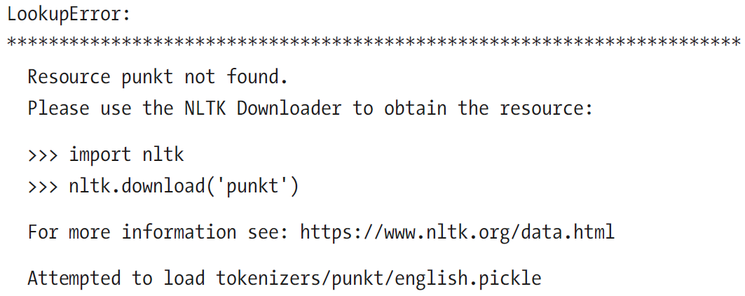

Slide 29
If you see such errors, simply run these lines:
  import nltk
  nltk.download()
We can individually select the packages that we need to install. You can only select book that will install the required models and tools for examples in the official NLTK book and documentation and include the examples in this book as well.

Slide 30
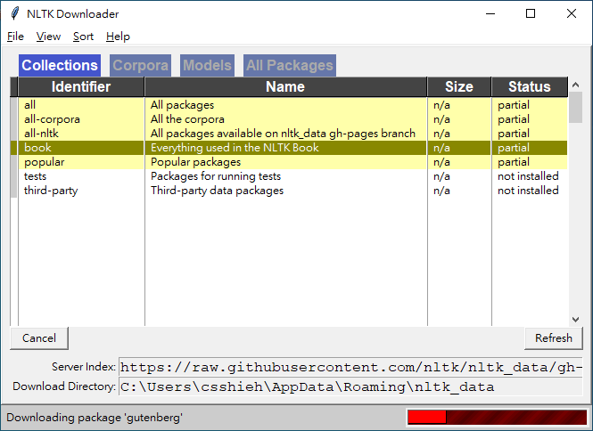

Slide 31
Five-Step NLP Pipeline
When you encounter textual data, one of the primary aims should be to develop a pipeline that takes text as input and produces vectors for each sentence or document (or whatever unit of data you wish to consider). It goes through the following steps:
  Segmentation
  Tokenization
  Stemming and Lemmatization
  Removing Stopwords
  Preparing Word Vectors

Slide 32
1. Segmentation
Segmentation is the process of finding the sentence boundaries.
Each sentence is a fully formed unit that conveys a meaning.
In English, a full stop denotes the boundary of a sentence – but it is not always true.
There are more complex and practically usable approaches that leverage Maximum Entropy Models to segment the sentences.

Slide 33
2. Tokenization
Tokenization breaks a sentence or a sequence into individual components or units called tokens.
The tokens can be words, special characters, numbers, etc.
Sample code
  from nltk.tokenize import word_tokenize
  word_tokenize("Let's learn machine learning")
  tokens = [t.lower() for t in word_tokenize("Let's learn machine learning")]
  print (tokens)

Slide 34
3. Stemming and Lemmatization
For grammatical reasons, the same word root can be present in different forms in the text. In most cases, they lead to a similar meaning, for example, work, working, worked – all convey a similar meaning in essence, though the interpretation is slightly different.
Stemming is the process of extracting the word root.

Slide 35
One popular method used for stemming is called Porter’s Stemmer.3 It performs a set of rule-based operations like the following:
  SSES -> SS
  IES -> I
  SS -> SS
  S ->
We can use Porter Stemmer’s implementation in NLTK in Python.

Slide 36
  from nltk.tokenize import word_tokenize
  word_tokenize("Let's learn machine learning")
  tokens = [t.lower() for t in word_tokenize("Let's learn machine learning")]
  print (tokens)
  from nltk.stem.porter import PorterStemmer
  stemmer = PorterStemmer()
  for token in tokens:
  print(token, " : ", stemmer.stem(token))

Slide 37
4. Removing Stopwords
There are several high-frequency words that increase the memory usage but can be ignored with minimal increase in the error. They often add a lot of noise and slow down the processes. These words, like “a,” “and,” “now,” etc., are called stopwords, and NLTK can help us remove them by matching with a word list.
  from nltk.corpus import stopwords
  eng_stopwords = stopwords.words('english')
  for token in stemmed_tokens:
  if token in stopwords.words('english'):
  stemmed_tokens.remove(token)

Slide 38
You can check the complete list of stopwords mentioned in NLTK by printing the values of eng_stopwords. At the time of writing, it contains 179 words. However, these words comprise more than 20% of the English text, thus causing immediate reduction of the size of data.

Slide 39
5. Preparing Word Vectors
As with all other types of data, text also needs to be converted into a vector form.
We have several mechanisms – the simplest being treating a data point (or a sentence) as a bag of words, which can be encoded similar to one-hot mechanism with variation to either put the number 1 in the columns representing all the present words or put the count of the number of occurrences of the word in the given sentence. An

Slide 40
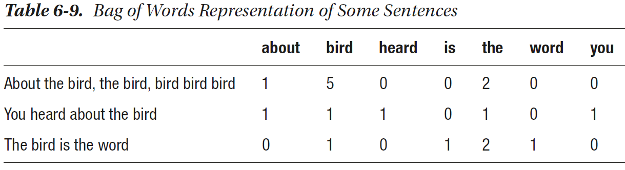

Slide 41
For this purpose, we can use CountVectorizer or one of the other Vectorizers available in Scikit-learn. We will see the use of these in the following end-to-end example.
  from nltk.tokenize import word_tokenize
  from nltk.corpus import stopwords
  from nltk.stem.porter import PorterStemmer
  from sklearn.feature_extraction.text import CountVectorizer
  stemmer = PorterStemmer()
  eng_stopwords = stopwords.words('english')
  data = ["Let's learn Machine Learning Now", "The Machines are Learning",
  "It is Learning Time"]
  tokens = [word_tokenize(d) for d in data]
  tokens = [[word.lower() for word in line] for line in tokens]

Slide 42
  for i, line in enumerate(tokens):
  for word in line:
  if word in stopwords.words('english'):
  line.remove(word)
  tokens[i] = ' '.join(line)
  matrix = CountVectorizer()
  X = matrix.fit_transform(tokens).toarray()

Slide 43
Here, X will become a 2D array of the shape = (m,n) where m is the number of rows in the data and n is the vocabulary size, or the number of unique words that are considered to represent a text vector.
You can visualize the text vectors by comparing feature names with the values:
  pd.DataFrame(X, columns=matrix.get_feature_names())

Slide 44
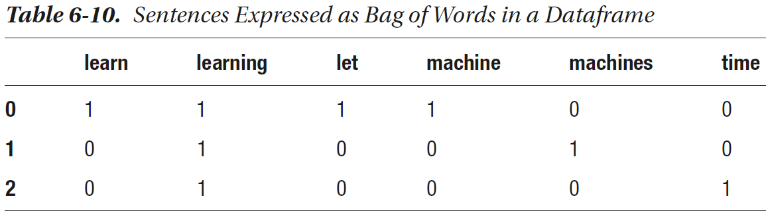

Slide 45
Preprocessing Images
Processing images is a large subset of machine learning and computer vision that has been dealt with in separate books.
In this section, we would introduce the basic concepts that might be required in some of the examples in this book.

Slide 46
Full-color images can be seen as a three-dimensional array, where two dimensions are used to represent the row and column number of a pixel and the third dimension represents the color channel, red, green, or blue. The value in each cell represents the intensity of each color channel at the given cell.

Slide 47
One simple way to reading an image as a three-dimensional array is to use Matplotlib’s imread function.
  import matplotlib.pyplot as plt
  img = plt.imread('C:\\Users\\johndoe\\Documents\\ Images\\puppy.jpg’)
  # img = plt.imread('/home/johndoe/Pictures/puppy.jpg’) for Linux
  plt.imshow(img)
  plt.imshow(img[:,:,0])
  cropped_image = img[200:1000,700:1500, :]
  plt.imshow(cropped_image)

Slide 48
There are extensive libraries for image processing and computer vision, the most popular being OpenCV and Scikit-Image.
Here’s an example on detecting edges using Scikit-Image, which produces the output as shown in Figure 6-5.
  from skimage import io,filters
  img = plt.imread('C:\\Users\\johndoe\\Documents\\ Images\\puppy.jpg')
  edges = filters.sobel(img)
  io.imshow(edges)
  io.show()

Slide 49
Summary
Using the methods present in this chapter, you should be able to capture your data, transform it to the expected format, and perform necessary scaling before sending it to the next steps down the machine learning pipeline.

Slide 50
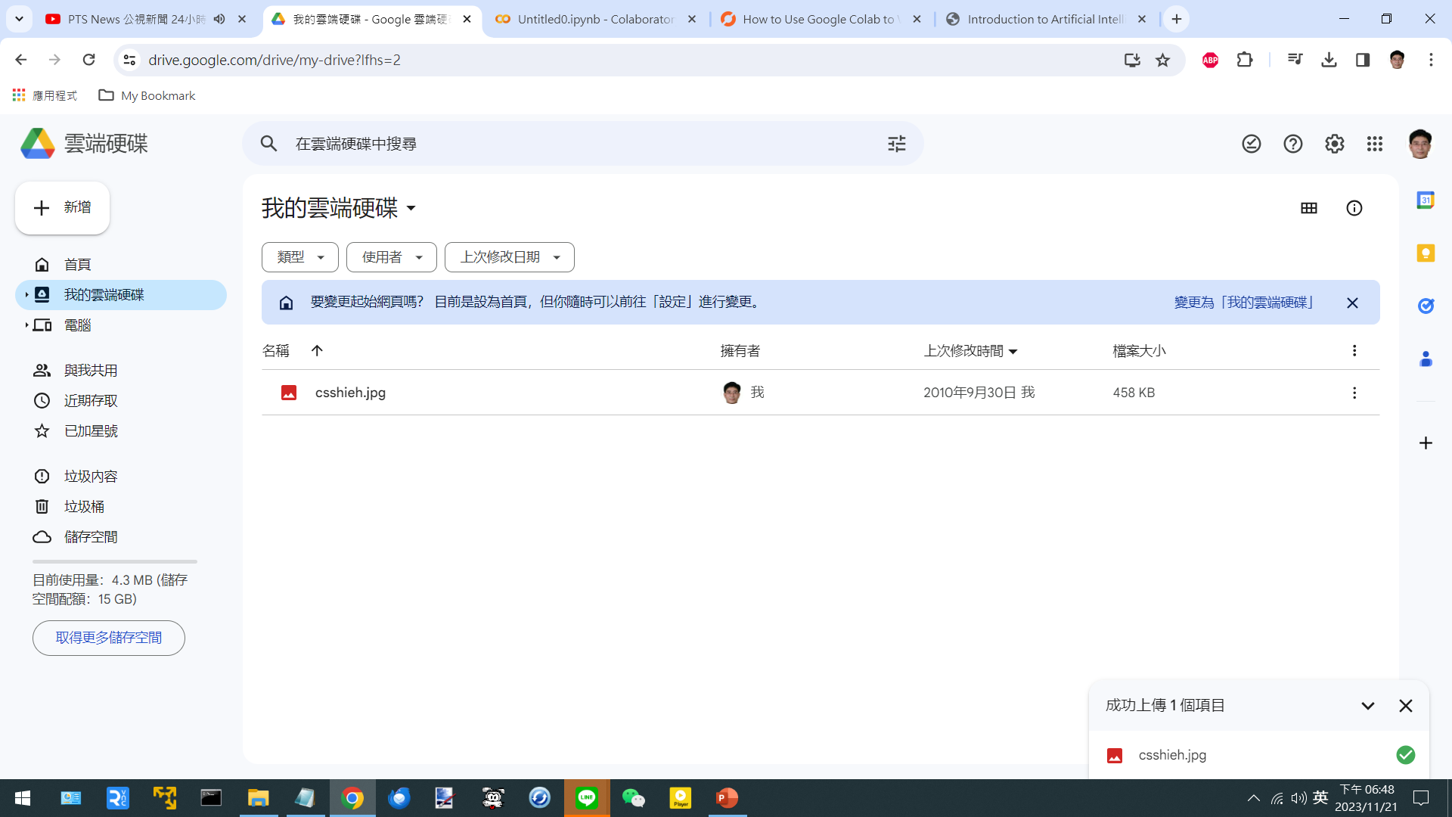

Slide 51
from google.colab import drive
drive.mount('/content/drive')
import matplotlib.pyplot as plt
img = plt.imread('/content/drive/MyDrive/csshieh.jpg')
plt.imshow(img)

Slide 52
